Slide 1
Demand for Health Care
Vinish Shrestha
Lecture 2
Reading: Chapter 2 in Book

Slide 2
Econ 339 - Roadmap
Focus Midterm 1
Focus Midterm 2
Focus Final
Review of Microeconomics
Demand for Insurance
Chapter 7
Uncertainty
Risk aversion
The health policy conundrum
Chapter 15
Capital stock K
Intro (from my slides)
Adverse selection
Chapters 8 and 9
Akerlof’s market for lemons
Rothschild-Stiglitz model
The Beveridge Model
Chapter 16
Production of Health (from my slides)
Demand for health care
Chapter 2
The American Model
Chapter 18 and slides provided (ACA)
Adverse Selection in
Real market
Chapter 10
The Grossman model
Chapter 3
Socioeconomic
Disparities
Chapter 4
Special Topics (if time allows)
Chapter 20
Slides provided
Moral hazard
Chapter 11

Slide 3
Concepts
Law of Demand
Law of Demand in Health Economics
Observational studies
Randomized control trials
Rand Health Insurance experiment and Oregon Medicaid experiment
Correlation versus causality
Non-random experiment and causality
Price of health care and health

Slide 4
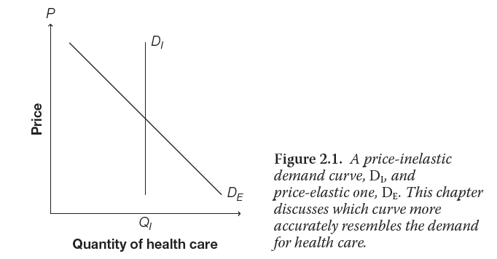

Slide 5
Demand for health care (health products)
Is the demand for health care downward sloping?
Do people react to increase in prices by reducing the quantity of utilization?
What happens if demand for health care is perfectly inelastic?
Policy
ACA subsidies
Would incentives (to increase access to health care) work?
What does it mean to have a downward sloping demand?
Price sensitive

Slide 6
How do we know if demand for health care is downward sloping?
Survey
Would you undergo surgery if the price was higher or lower?
Some drawbacks?
2. Insured versus uninsured people
Hypothesis is that insured people face lower price (out of pocket expenses) compared to uninsured people
Some drawbacks?
Randomized study
Randomly assigns treatment and control status
i.e. randomly assigns copayment rates (Rand Health Insurance)

Slide 7
Health Insurance Experiments
Rand Health Experiment
Conducted between 1974 and 1982
Randomly assigned 2000 families six American cities to one of several different health insurance plans
Plans had different coinsurance rates

Slide 8
Rand Health Experiment
Coinsurance rate: the fraction of medical bill for which the patient is responsible. (given in percentage).
Deductible: A part that the patient needs to take care of before the insurance kicks off.
Copay: Fixed amount of payment, predetermined.
Cost sharing: one with positive coinsurance and copayment rate; costs are shared between insured and insurer.

Slide 9
Cost-Sharing: How does it work?
Medical Expenses: $1000
Deductible: $500
Coinsurance: 40%
Copay: $25
Your share: Deductible + Coinsurance + Copay
Your share: $500 + (500 *0.4) + 25 = 500+200+25 = $725

Slide 10
Average number of annual episodes by condition Evidence for Outpatient Care (RAND HIE)
Type of Plan | Total | Acute | Chronic
Free | 2.99 | 2.29 | 0.70
25% | 2.32 | 1.78 | 0.54
50% | 2.11 | 1.60 | 0.51
95% | 1.90 | 1.44 | 0.46

Slide 11
Inpatient versus Outpatient Care
Outpatient care:
interaction that does not result in an overnight stay.
Less complex
Ambulatory care
Inpatient care:
Involves overnight stay in hospital

Slide 12
Average number of annual episodes by condition Evidence for Inpatient Care (RAND HIE)
Type of Plan | Total
Free | 0.133
25% | 0.109
50% | 0.099
95% | 0.098

Slide 13
Oregon Medicaid Experiment
Compared usage between two groups of people
Oregonians who won a 2008 lottery to gain access to public health insurance through Medicaid
Those who did not win
Oregon Medicaid Experiment Outpatient Care |  |  | Inpatient care
 | % with visit | Number of visit | % with visit | Number of visit
Lottery winners | 63.6 | 2.22 | 26.7 | 0.48
Lottery losers | 57.4 | 1.91 | 26.1 | 0.47

Slide 14
Nepal’s Experiment to Track the Demand for Sanitary Pads

Slide 15
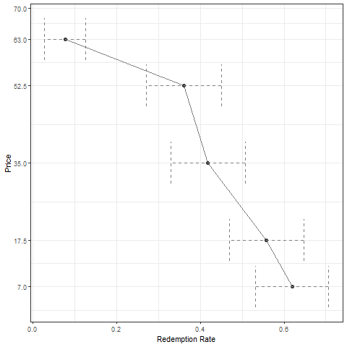
Discount of 10%, 25%, 50%, 75%, 90%

Slide 17
Non-Randomized Experiment
U.S. Medicare
Citizens are eligible for health insurance through Medicare when they turn 65 but not before
If demand curve for health product is downward sloping we would want to see a jump in health care at 65
Age of 65 creates a discontinuity (which is valuable in identifying causal effects)

Slide 18
Card et al. (2009)
Card et al. have two main findings:
Unplanned emergency department admissions follow a linear trend around the age of 65
Other hospital admissions jump up at the age of 65
There is a discontinuity in medical usage at the same point of discontinuity in Medicare coverage!
This is further evidence that demand for health care is sensitive to price

Slide 20
So, what do we learn?

Slide 21
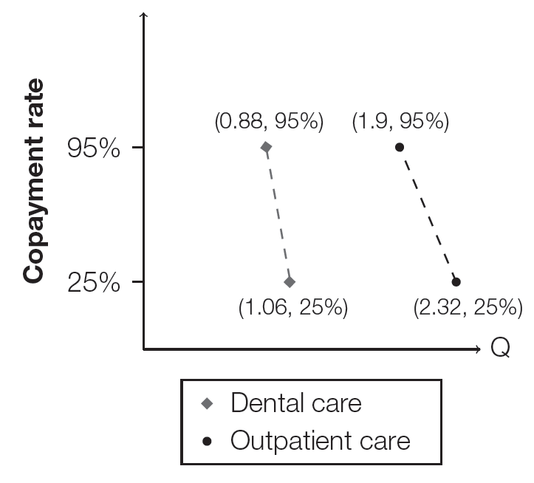
Elasticities

Slide 22
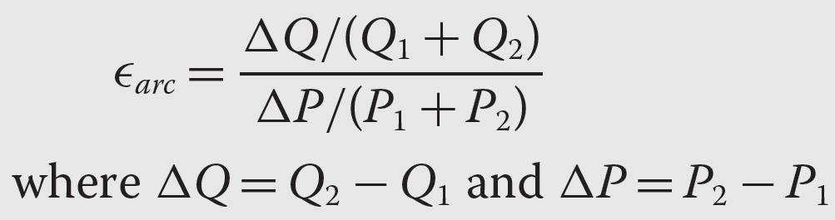
Arc Elasticity
Need a measure to compare the relative price sensitivity of different goods
So the measure needs to be unitless (how else would we compare ER visits to sticks of gum?)
Arc Elasticity:

Slide 23
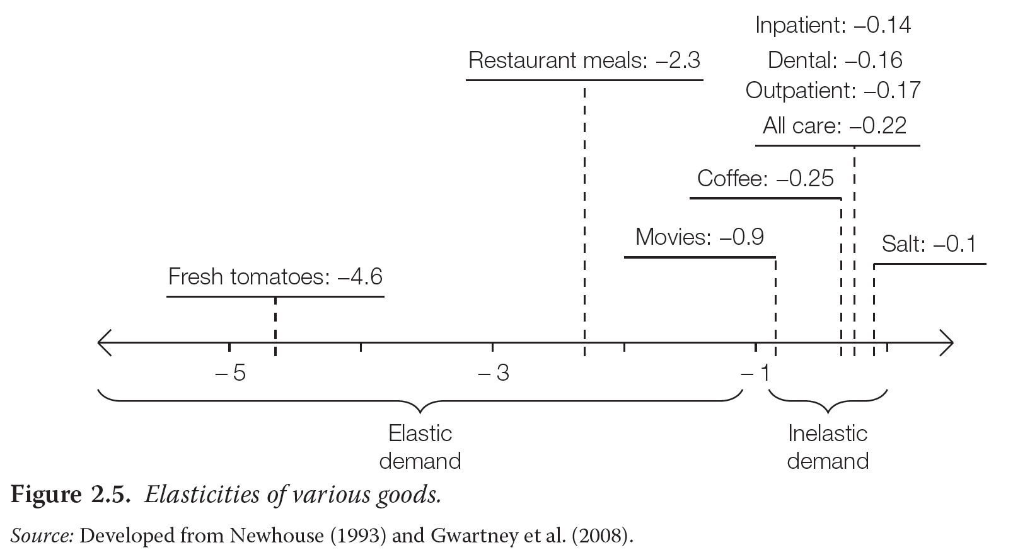
Health care has inelastic demand

Slide 24
Does price for care affect health?
Mortality rates
RAND HIE: no difference between treatment groups
** 10% difference of mortality rate between high-risk participants on free and cost-sharing plans (people on free plan less likely to die)
Oregon Medicaid: no difference between lottery winners and losers

Slide 25
Does the price of care affect health?

Slide 26
Calculating Elasticity
Copayment plan | Quantity of outpatient visit
25 % | 2.32
95 % | 1.9

Slide 27

Calculating elasticity. Which way?
Base point matters
$\text{ɛ}\text{ = }\frac{Q2−Q1/Q1}{P2−P1/P1}$
$\text{ɛ = }\frac{Q2−Q1/Q2}{P2−P1/P2}$
$\text{ɛ = }\frac{Q2−Q1/(Q1+Q2)}{P2−P1/(P1+P2)}$

Slide 28
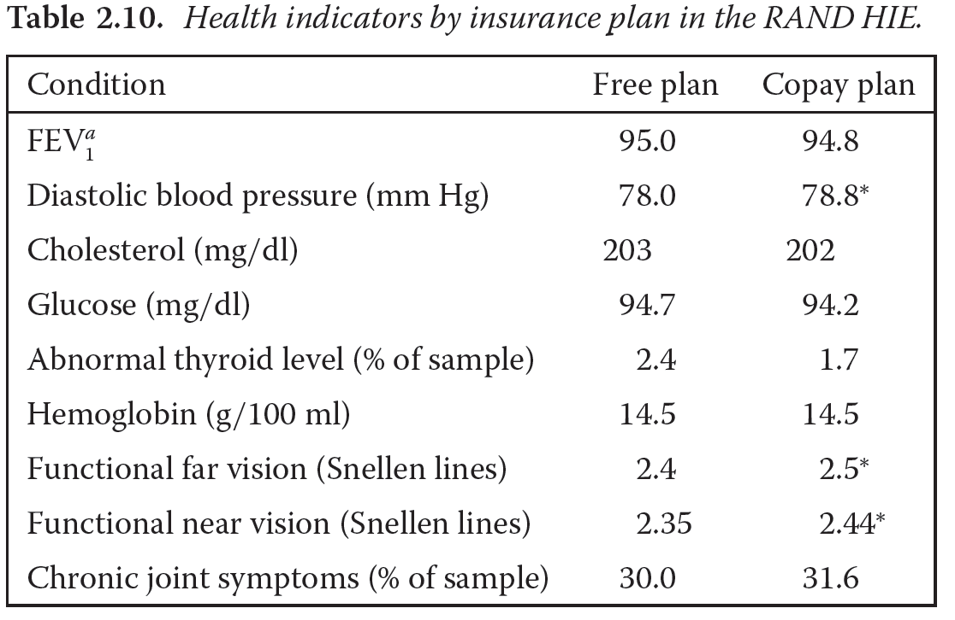
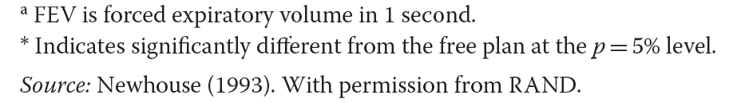
Does price for care affect health?
RAND HIE:
Generally, no health differences between people on free plan vs. cost-sharing!
**Only statistically significant difference between plans were in blood pressure, myopia, & presbyopia

Slide 29
Does price for care affect health?
Oregon Medicaid Experiment
Lottery winners self-reported better overall health, more healthy days, and lower rates of depression
Discrepancy with RAND HIE may be because Oregon Medicaid Study worked with the very low-income, while RAND HIE studied a broader cross-section of the U.S.

Slide 30
Conclusion
Demand curves for health care are downward sloping
Quantity of care demanded is sensitive to price (though not as sensitive as other demands, e.g. for movies)
BUT generally, price of health care does not seem to affect one’s health
Exception is that price seems to affect the most vulnerable segments of the population (low-income, high blood pressure, etc.)
Policy and health insurance implications?

